Slide 1



Git and GitHub for R Projects with RStudio
Lukas M. Weber, PhD
Assistant Professor
Department of Biostatistics
Boston University
September 18, 2025
lmweber.org

Slide 2


Overview
Introduction to Git and GitHub
Use cases and examples
Interactive demo and exercises using RStudio

Slide 3

Git and GitHub
System for managing code
version control (tracking changes)
collaboration
organizing projects
publishing and sharing code
reproducibility
References and additional materials:
Software Carpentry lesson on “Version Control with Git”: https://swcarpentry.github.io/git-novice/

Slide 4
Git and GitHub
Git and GitHub refer to two separate but related concepts:
Git: command-line utility
available from command-line as well as (more recently) interfaces in development environments such as RStudio
developed in 2005 by Linus Torvalds (creator of Linux operating system) as an improvement to earlier version control systems such as svn
GitHub: commercial website and collaboration environment
hosting service for Git repositories, allows collaboration by multiple users
started in 2008 and acquired by Microsoft in 2018
alternatives also exist (e.g. GitLab) but GitHub is most popular

Slide 5
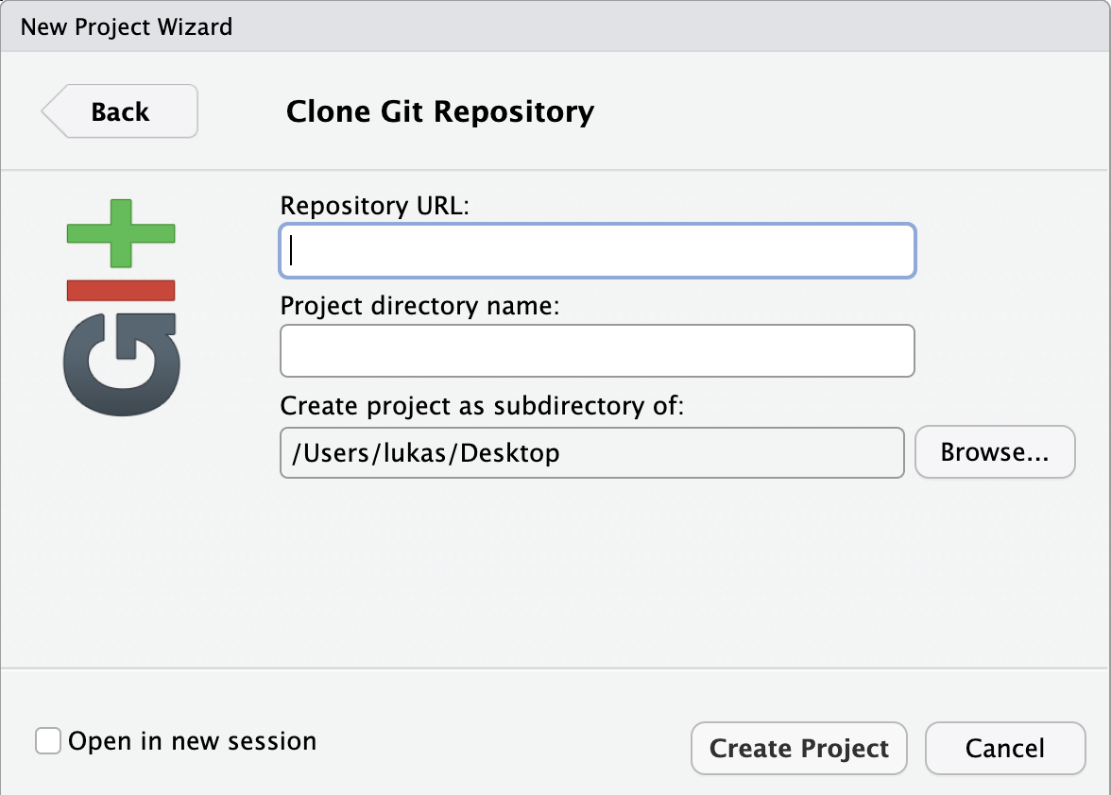
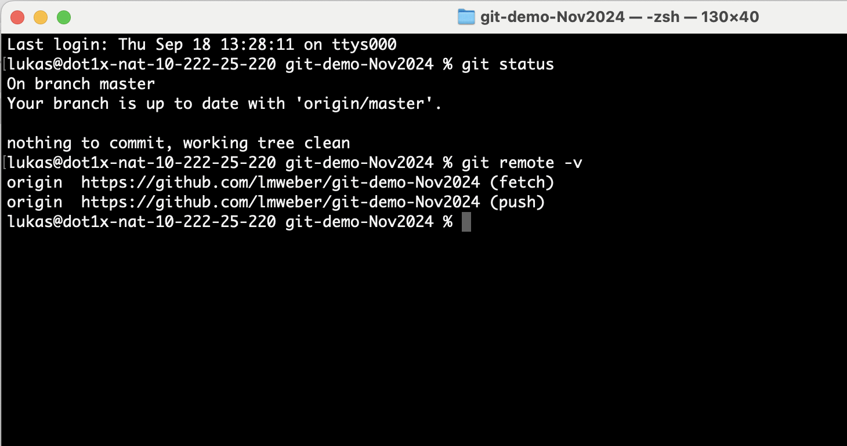
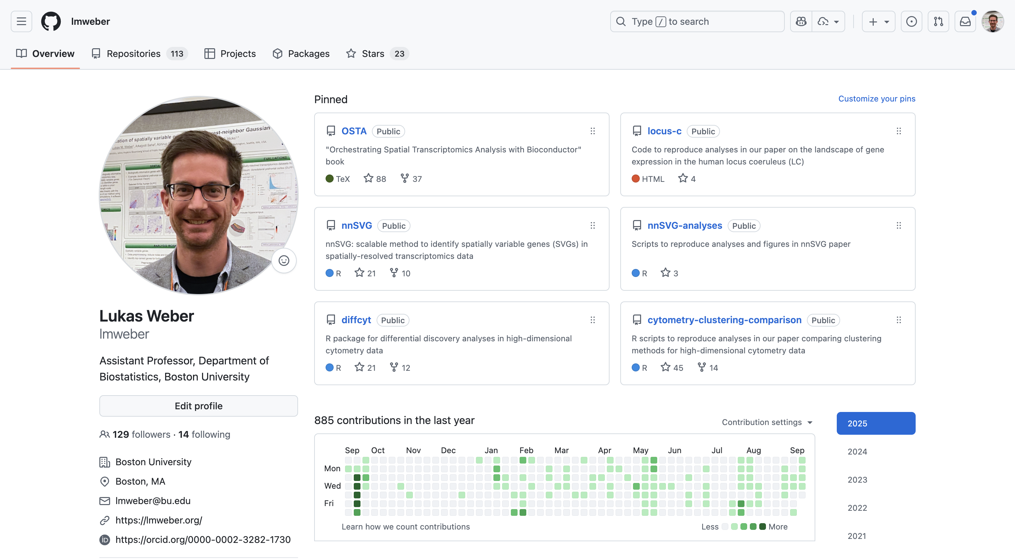
Git and GitHub
Git
GitHub

Slide 6
Why use Git and GitHub?

Slide 7
1. Version control
version control lets you keep track of updates / edits to your code scripts (or text) over time
nothing that is “committed” to version control is ever lost
can go back to look up previous updates, undo changes, go back to an earlier version
have a record of who made changes and when in a collaborative project
More details:
Software Carpentry lesson: https://swcarpentry.github.io/git-novice/

Slide 8
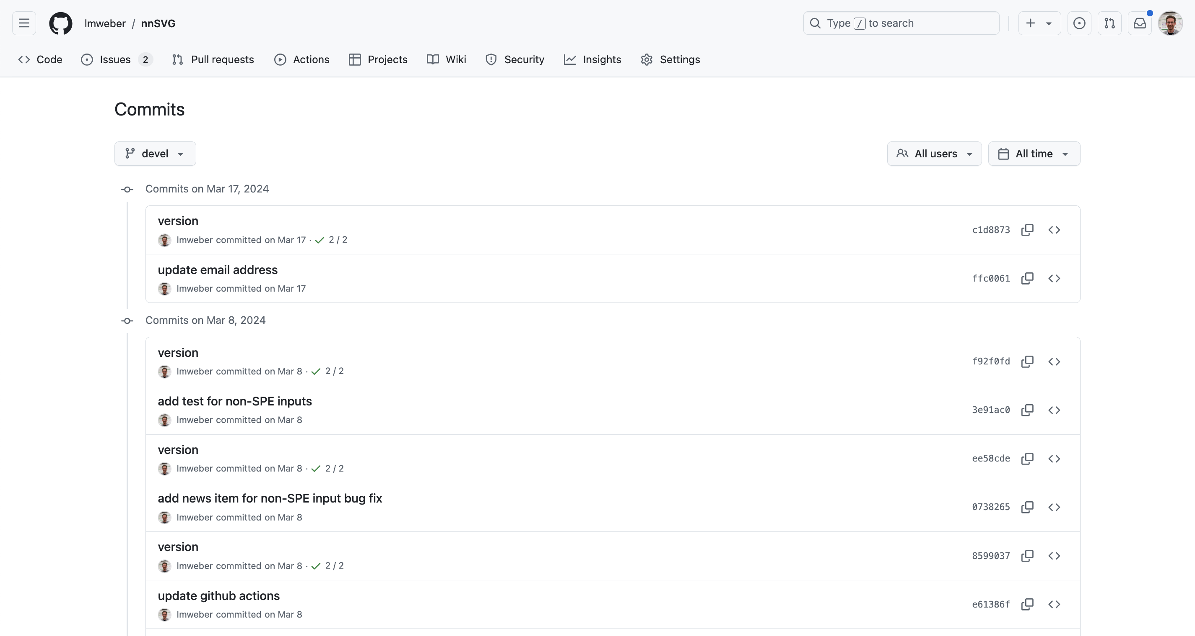
Terminology
“Commits”
specific updates to code scripts
includes a record of the author, email address, timestamp, and a “commit message”
can look up “commit history” on GitHub
Example https://github.com/lmweber/nnSVG

Slide 9
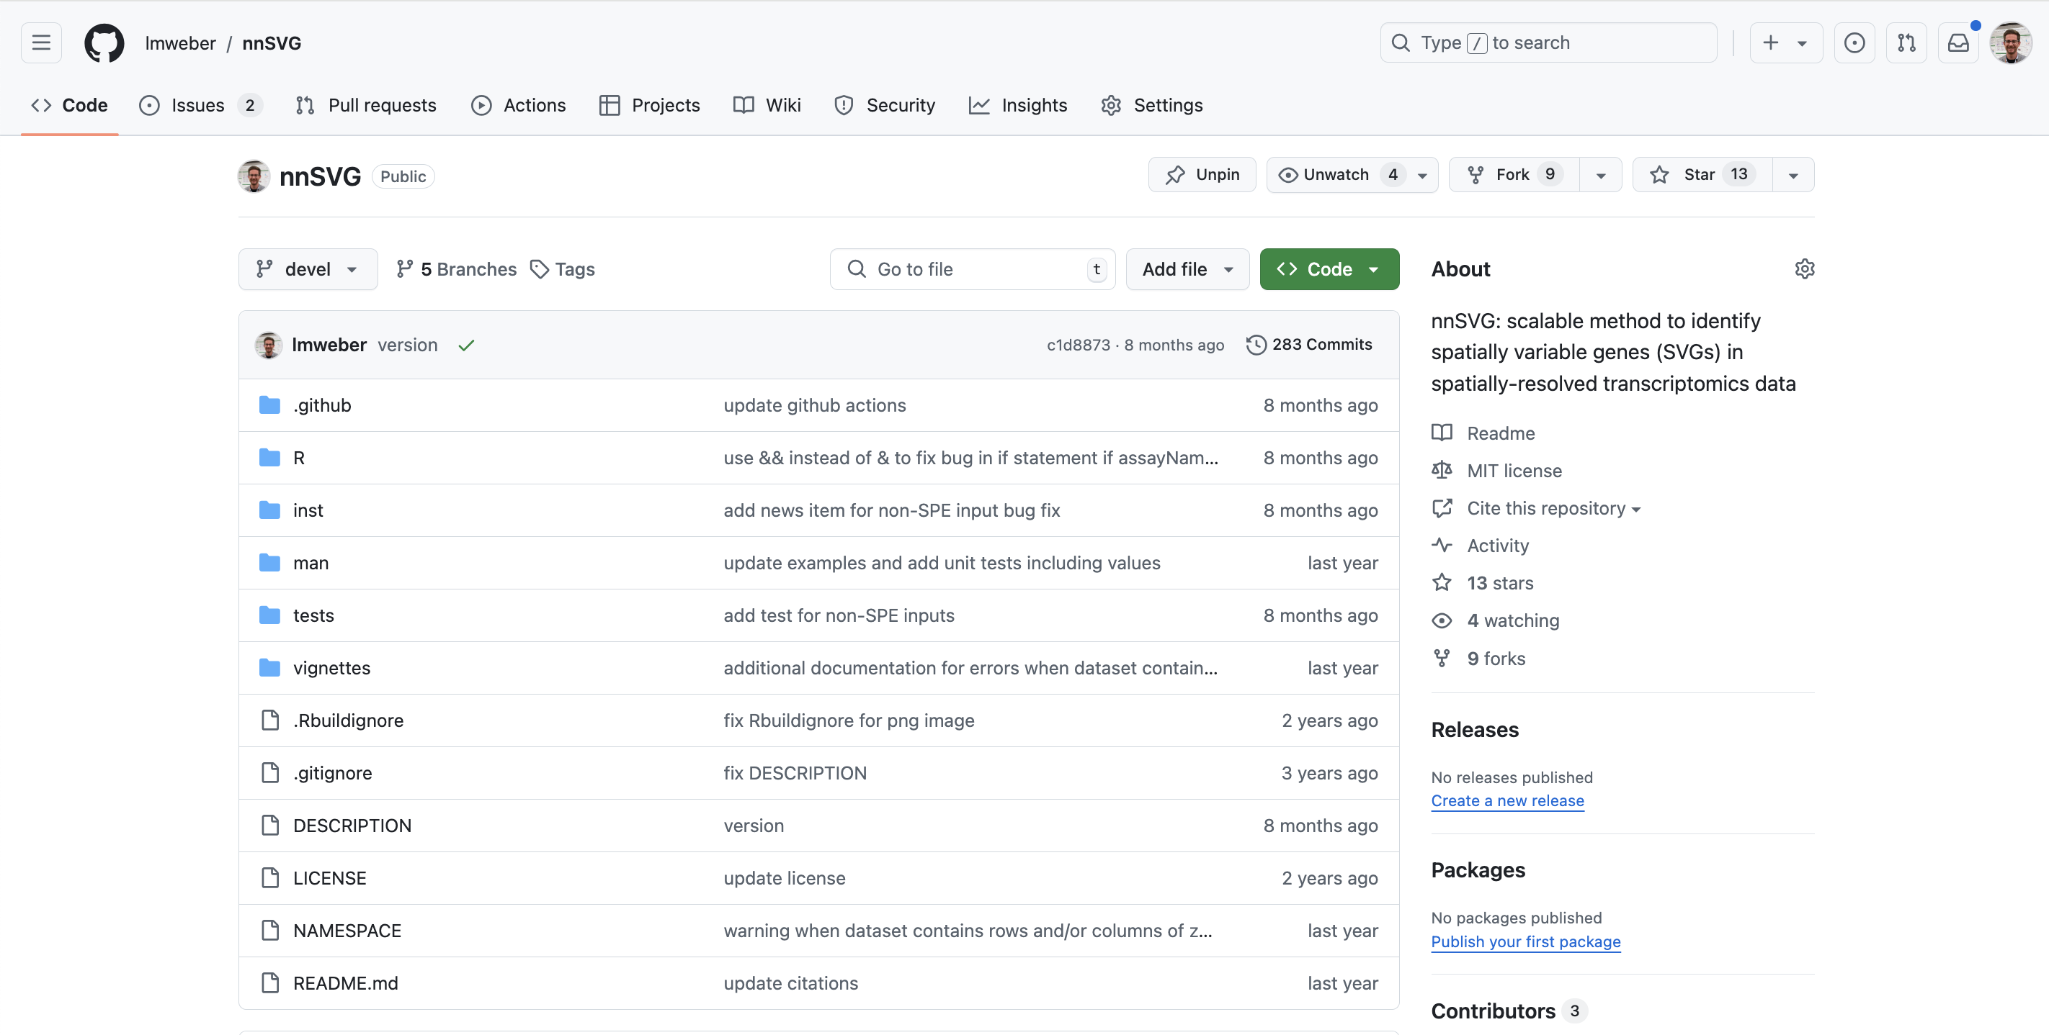
Terminology
“Repository”
project containing one or more version-controlled files in a directory
multiple people can contribute / collaborate
can be stored locally (on your computer) and linked publicly on GitHub
Example https://github.com/lmweber/nnSVG

Slide 10
Terminology
“Local” vs. “remote” repositories
local repository: stored in a directory on your computer, used for your own work
remote repository (e.g. on GitHub): hosted on a server, enables collaboration, also used as backup or to keep track of your own projects
Example https://github.com/lmweber/nnSVG

Slide 11
Terminology
“Push”
share local changes to a remote repository
updates the remote repository with the local commits
“Pull”
retrieve changes from a remote repository
updates the local repository with the changes from the remote repository

Slide 12
Questions and setup
Questions?
Set up your GitHub account if you have not already
Use an email address that you will have long-term access to (e.g. Gmail)
Set up / update R and RStudio

Slide 13
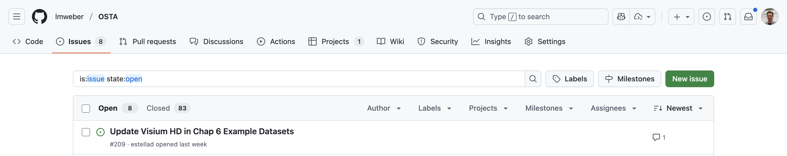
2. Collaboration
Multiple people can contribute to the same Git repository
GitHub provides a convenient interface for communication via “Issues”
Example (GitHub Issues): https://github.com/lmweber/OSTA

Slide 14
3. Publishing code
R packages
can store files for an R package in a GitHub repository
can install R packages directly from GitHub
library(remotes) # or library(devtools)
install_github("lmweber/nnSVG")
→ Example: https://github.com/lmweber/nnSVG

Slide 15
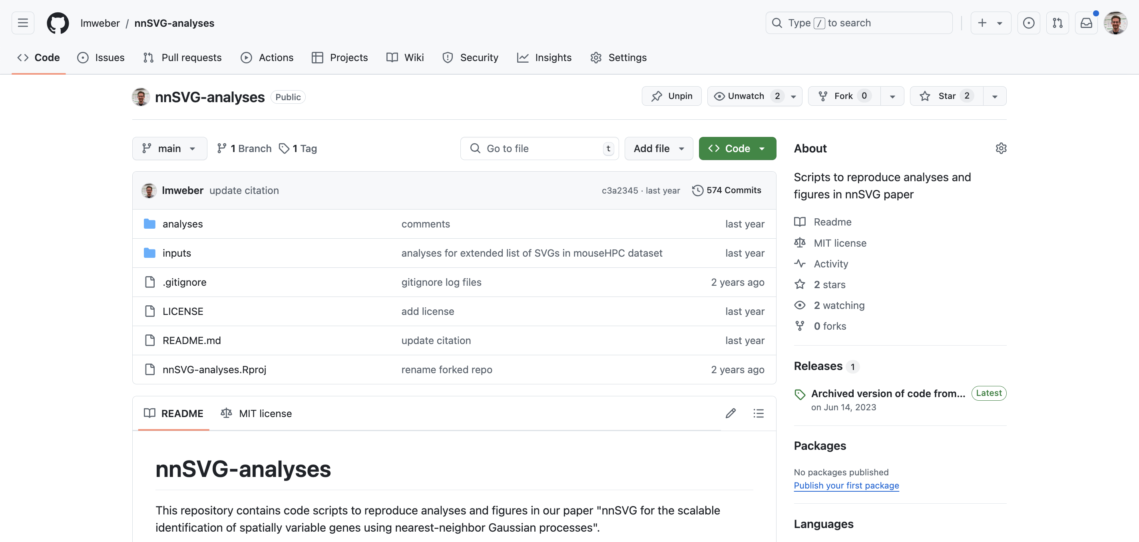
4. Reproducibility
Analysis code repositories
store analysis code from a project
can include link in published paper for reproducibility
also useful as backup of important code
Example: https://github.com/lmweber/nnSVG-analyses

Slide 16
5. Coding best practices
Working with Git and GitHub makes it easier to follow good coding practices
Modularity: push “commits” to GitHub each time you have a small piece of code done (or at the end of the day / end of a coding session), instead of building up long / complicated scripts
Reproducibility: private or public repositories
Documentation: documentation files, readme pages

Slide 17
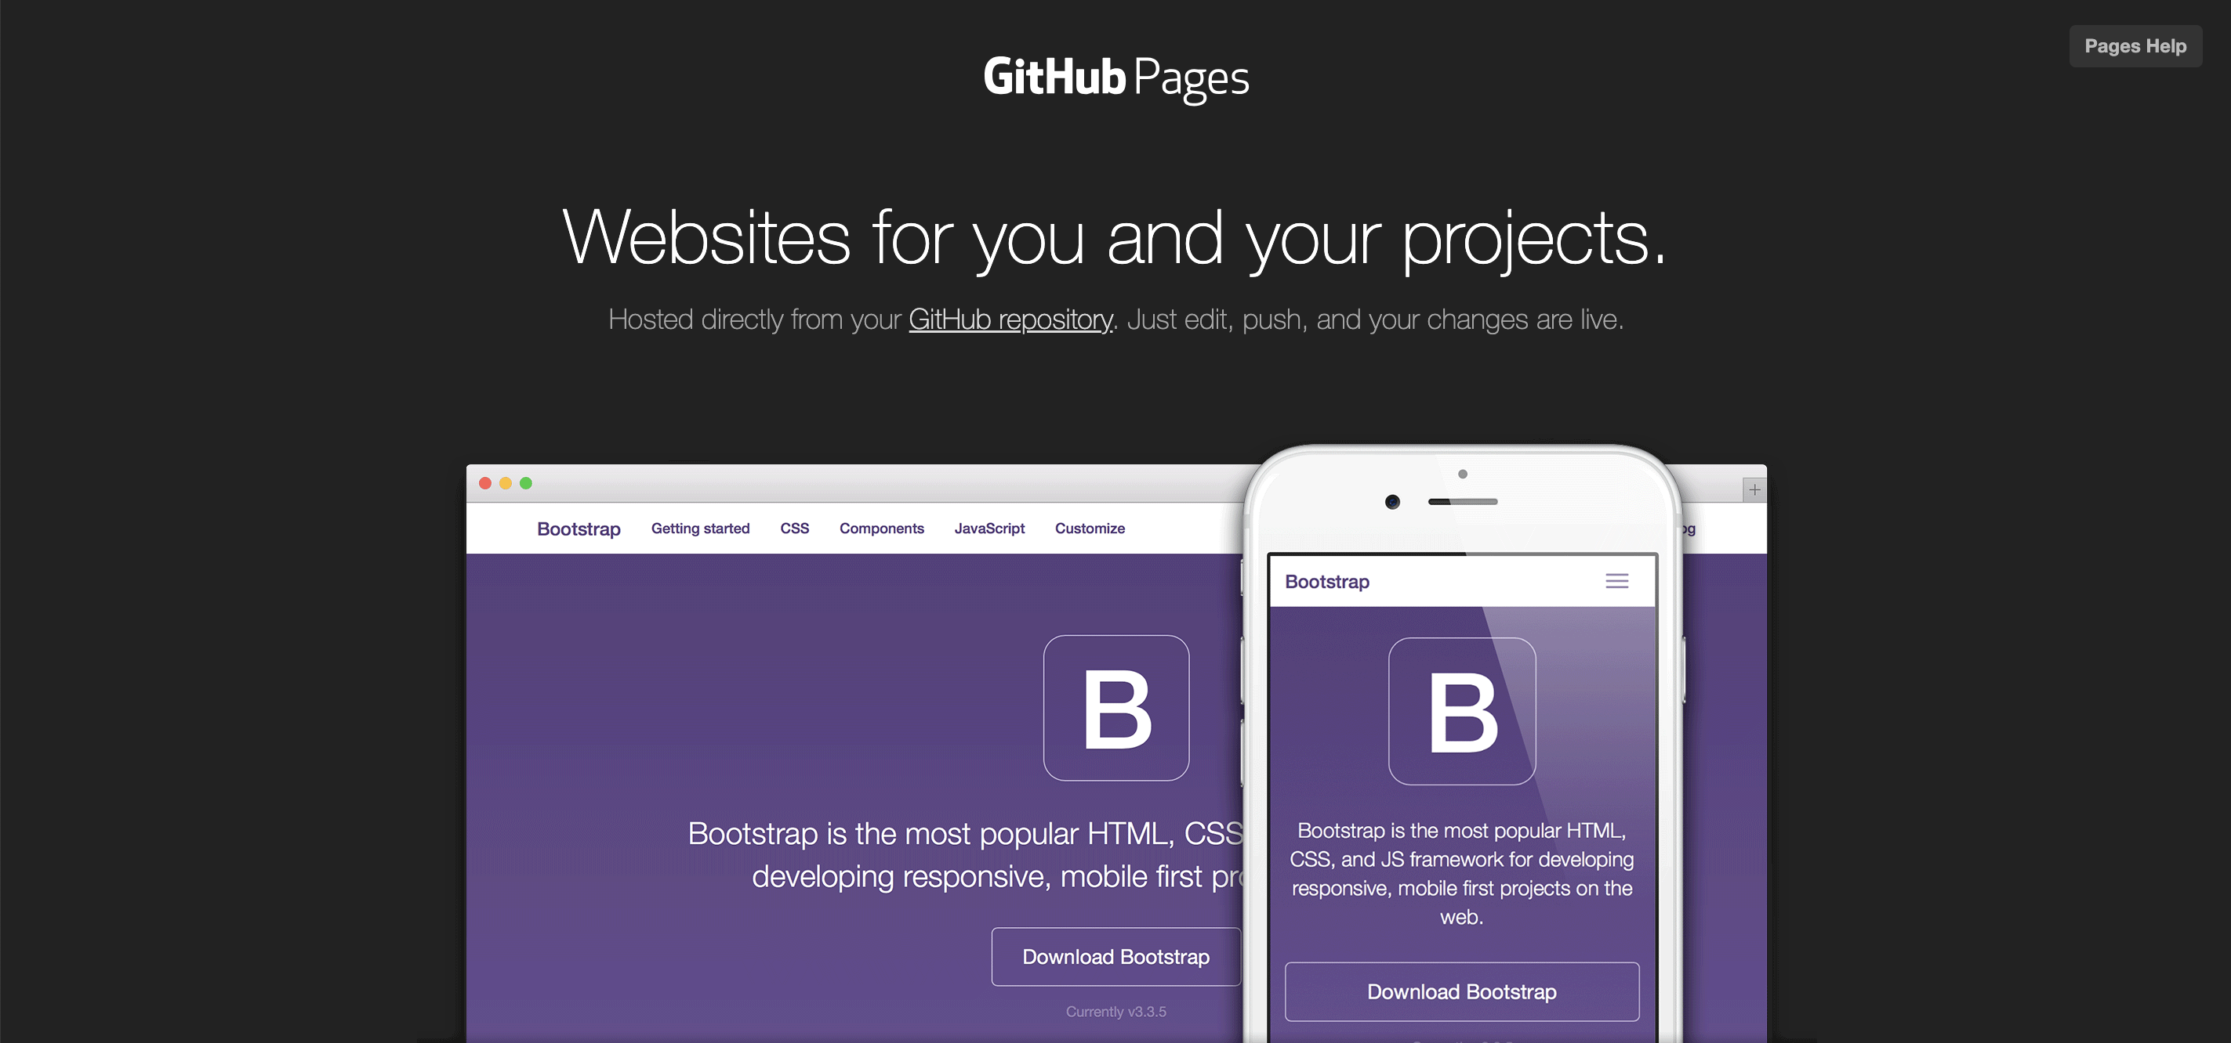
6. Websites and portfolio
GitHub Pages
GitHub provides a free hosting service for websites
templates available

Slide 18
6. Websites and portfolio
GitHub profile page
can use as portfolio of coding projects, e.g. for job applications

Slide 19
Interactive demo using RStudio

Slide 20
Setup
Create GitHub account
Install / update R and RStudio
Set up Git locally on your computer
Setting up Git locally on a computer for the first time can sometimes be complicated
After Git is set up, we will access it in RStudio

Slide 21
Setup
Check if you already have Git installed on your computer
type git config --global --list in RStudio Terminal window (or Terminal)
If not, follow Git installation instructions from Software Carpentry lesson: https://swcarpentry.github.io/git-novice/02-setup.html
You only really need to set up the following 3 settings:
git config --global user.name "Your Name"
git config --global user.email "your@email.com"
git config --global core.editor "nano"

Slide 22
Setup
Next, enable authentication settings in your GitHub account
Generate a “Personal Access Token” (more secure alternative to password)
Settings → Developer settings → Create Personal Access Token (classic)
Select “No expiration” for expiration date
Select all permissions for “repo”, “user”, and “workflow”
Save this and paste it in like a password whenever Git asks for it (using “https” authentication)
Alternatively, set up “ssh” authentication (more secure / more complicated to set up, but only need to set up once per computer)
Check your GitHub account has 2-factor authentication enabled (e.g. Google Authenticator app on your phone)
Create an “ssh key” in RStudio Git settings after setting up an RStudio project
Paste the “public” part of the ssh key into settings in your GitHub account
Check your local Git repository is using ssh authentication by typing “git remote -v”

Slide 23
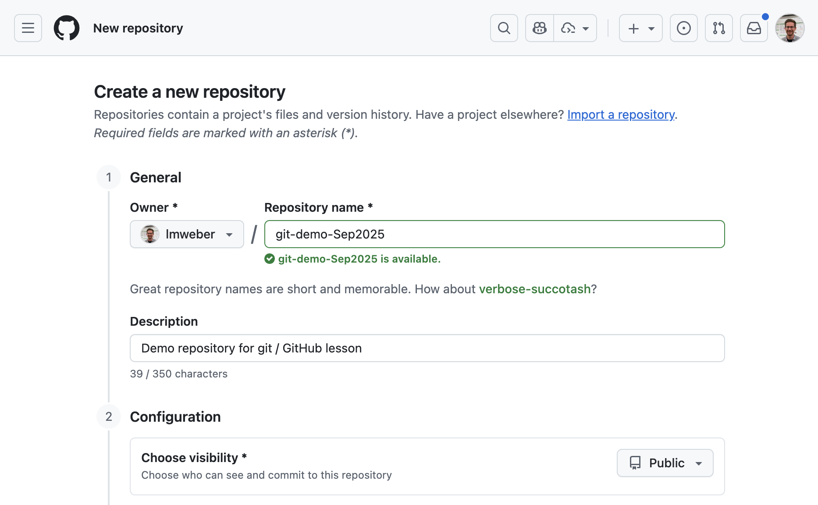
Create a repository on GitHub
Can either create a repository on GitHub and then download a copy on your computer, or create it locally and then link it on GitHub
We will do the first option (create it on GitHub)
→ Demo
Note various settings / options available

Slide 24
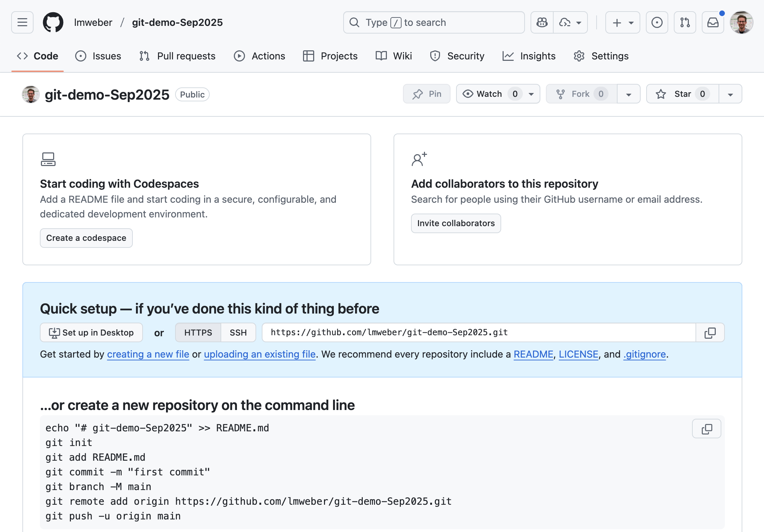
Create a repository on GitHub
Can either create a repository on GitHub and then download a copy on your computer, or create it locally and then link it on GitHub
We will do the first option (create it on GitHub)
→ Demo
GitHub then provides instructions for how to “clone” the repository locally using the command line
We will use RStudio instead

Slide 25
More terminology
“Clone”
download a local copy of a remote repository (e.g. from GitHub) onto your computer
“Fork”
create a copy / duplicate of a remote repository, e.g. a copy of someone else’s repository in your own GitHub account, where you can make your own changes
the new fork will branch off from the current version of the existing repository, so you can add changes while also keeping track of the original (“upstream”) repository

Slide 26
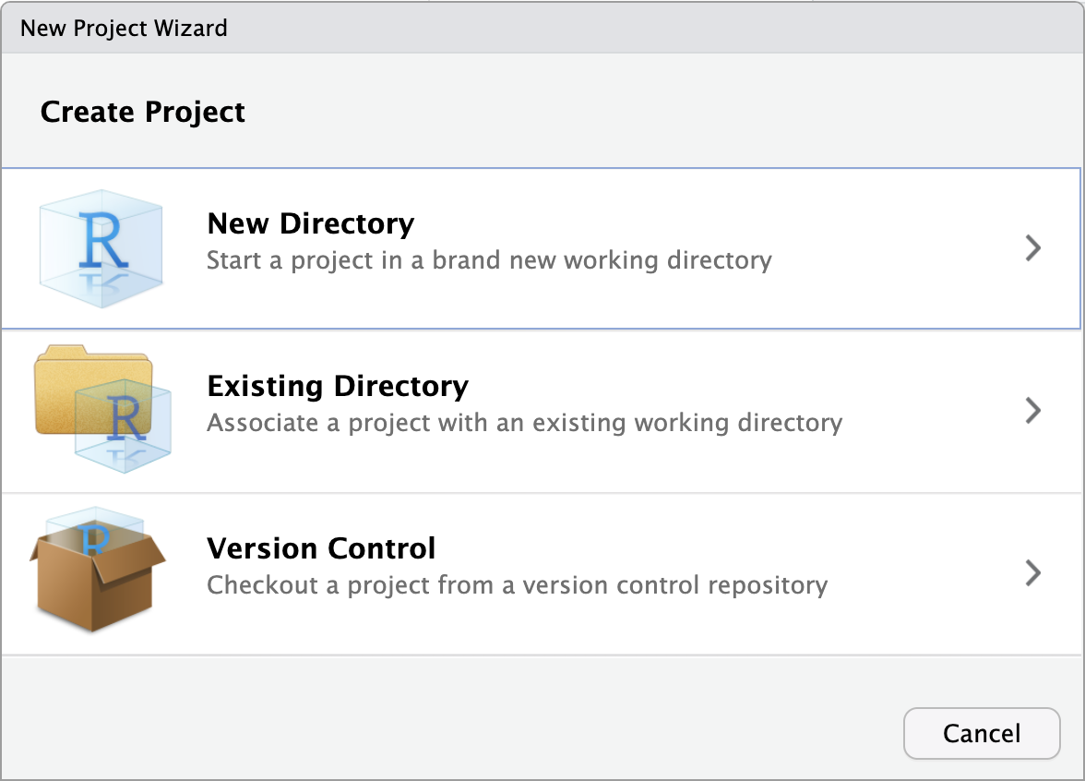
Create RStudio project
Now create an RStudio “Project” and link the repository from GitHub
RStudio projects are a convenient way to organize code and other files from a project in a single directory, e.g. multiple analysis scripts for a data analysis project
→ Demo
Select “Version Control” and “Git” to link a repository from GitHub

Slide 27
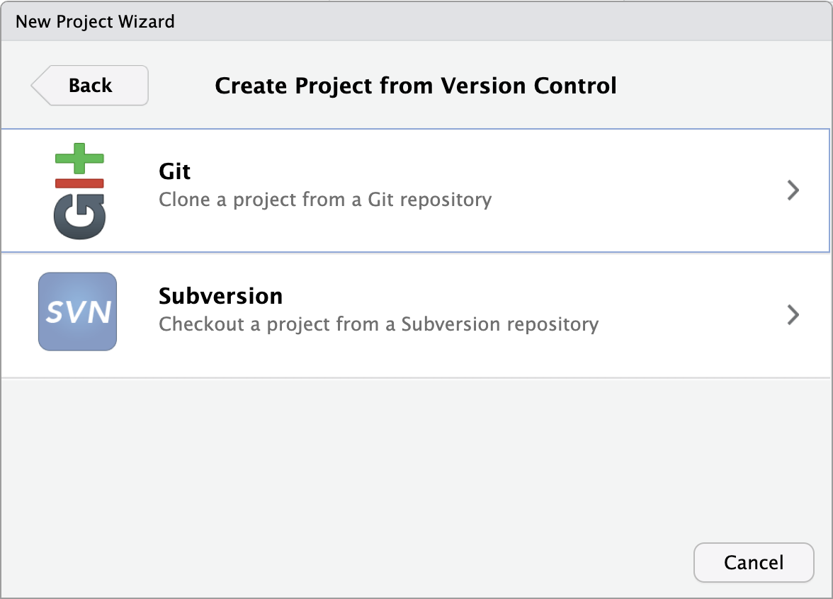
Create RStudio project
Now create an RStudio “Project” and link the repository from GitHub
RStudio projects are a convenient way to organize code and other files from a project in a single directory, e.g. multiple analysis scripts for a data analysis project
→ Demo
Select “Version Control” and “Git” to link a repository from GitHub
Paste in the repository URL

Slide 28
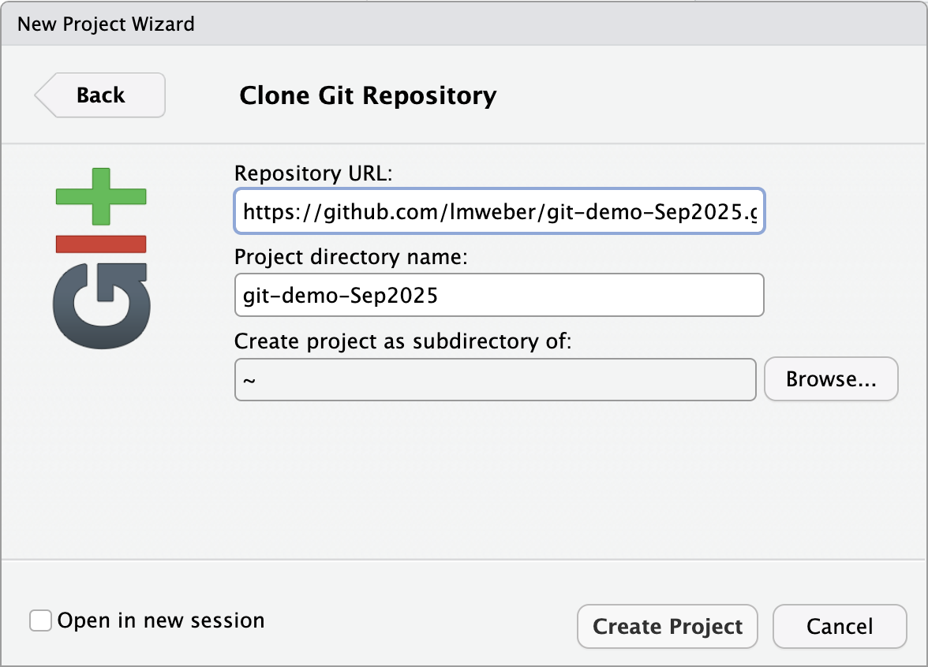
Create RStudio project
Now create an RStudio “Project” and link the repository from GitHub
RStudio projects are a convenient way to organize code and other files from a project in a single directory, e.g. multiple analysis scripts for a data analysis project
→ Demo
Select “Version Control” and “Git” to link a repository from GitHub
Paste in the repository URL

Slide 29
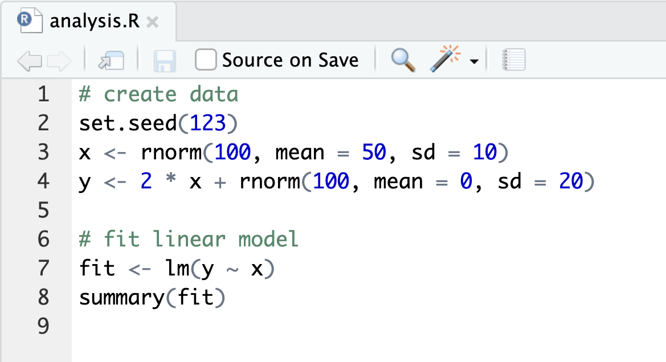
Add files to repository
Now we can add files locally in the project directory, and push them to the repository on GitHub
→ Demo
File > New File > R Script
Add some code and save file

Slide 30
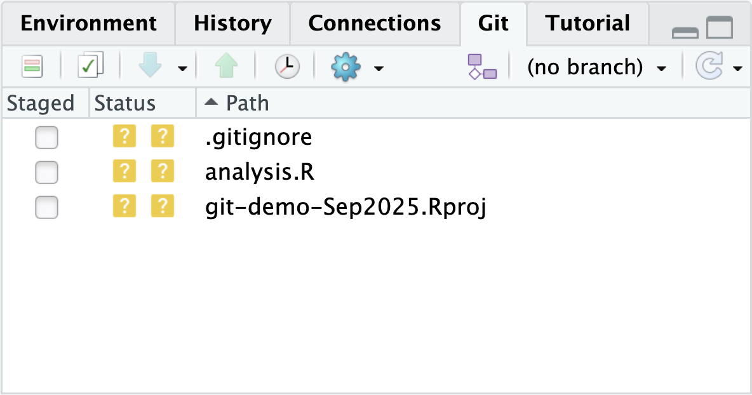
Add files to repository
Now we can add files locally in the project directory, and push them to the repository on GitHub
→ Demo
Check changes
Open the “Git” tab in the top-right corner of RStudio
You should see the new R script file listed under “Unstaged Changes”
“Stage” the changes: prepares them to be included in the next commit

Slide 31
More terminology
“Stage”
select which changes to include in the next commit, and prepare changes for the commit by adding them to the “staging area”
“Commit”
record a snapshot of changes to the repository – includes the changes along with a record of author, email address, timestamp, and “commit message”
“Push”
“push” commits from local repository to remote repository (i.e. updating remote repository)
“Pull”
“pull” commits from remote repository to local repository (i.e. updating local repository)

Slide 32
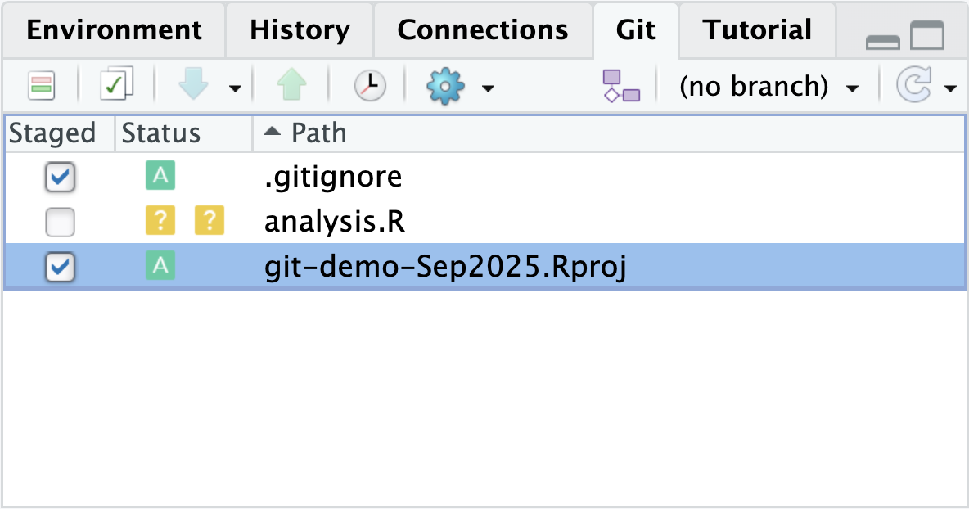
Add files to repository
Now we can add files locally in the project directory, and push them to the repository on GitHub
→ Demo
Check changes
Open the “Git” tab in the top-right corner of RStudio
You should see the new R script file listed under “Unstaged Changes”
“Stage” the changes: prepares them to be included in the next commit

Slide 33
Add files to repository
Save, stage, commit, and push the files
RStudio also provides an opportunity to check the changes before committing and pushing (“Diff” button, or opens automatically)
Note that we also have some additional files from creating the RStudio project, so we will split the updates into two commits (good coding practices: modularity)

Slide 34
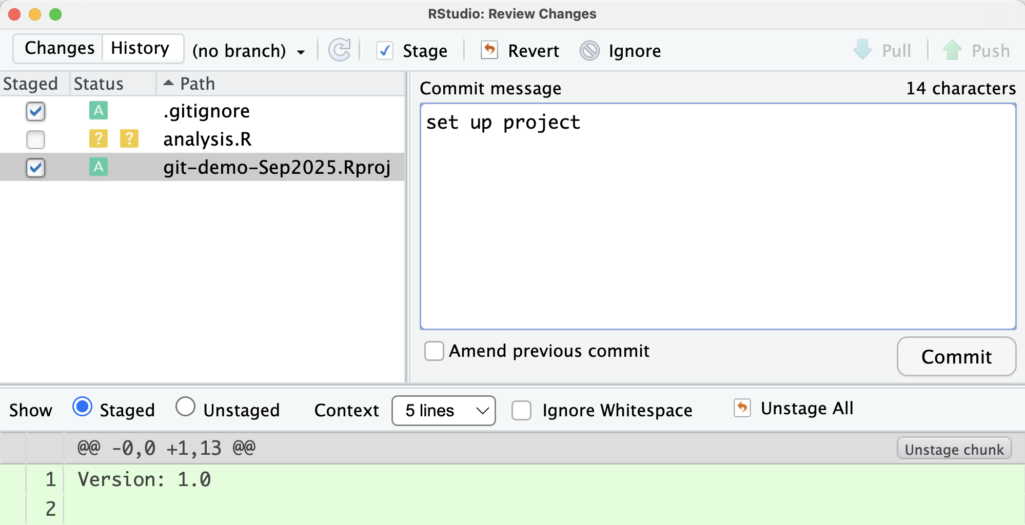
Add files to repository
Save, stage, commit, and push the files
Click on “Commit”, add a “Commit message”, then “Commit” again

Slide 35
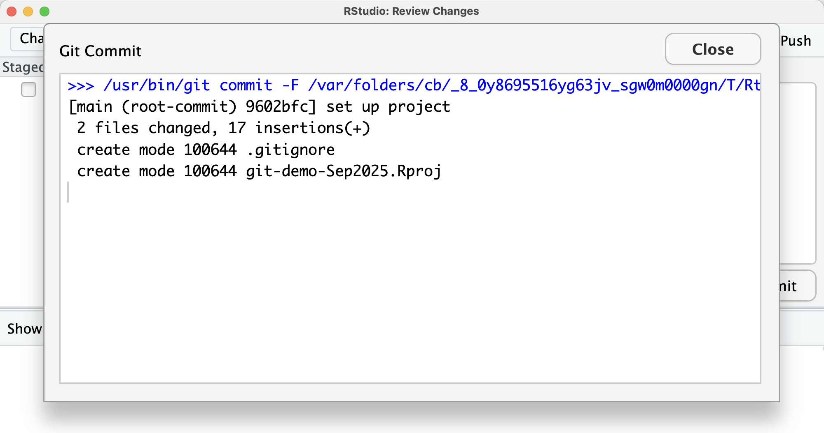
Add files to repository
Save, stage, commit, and push the files
Click on “Commit”, add a “Commit message”, then “Commit” again

Slide 36
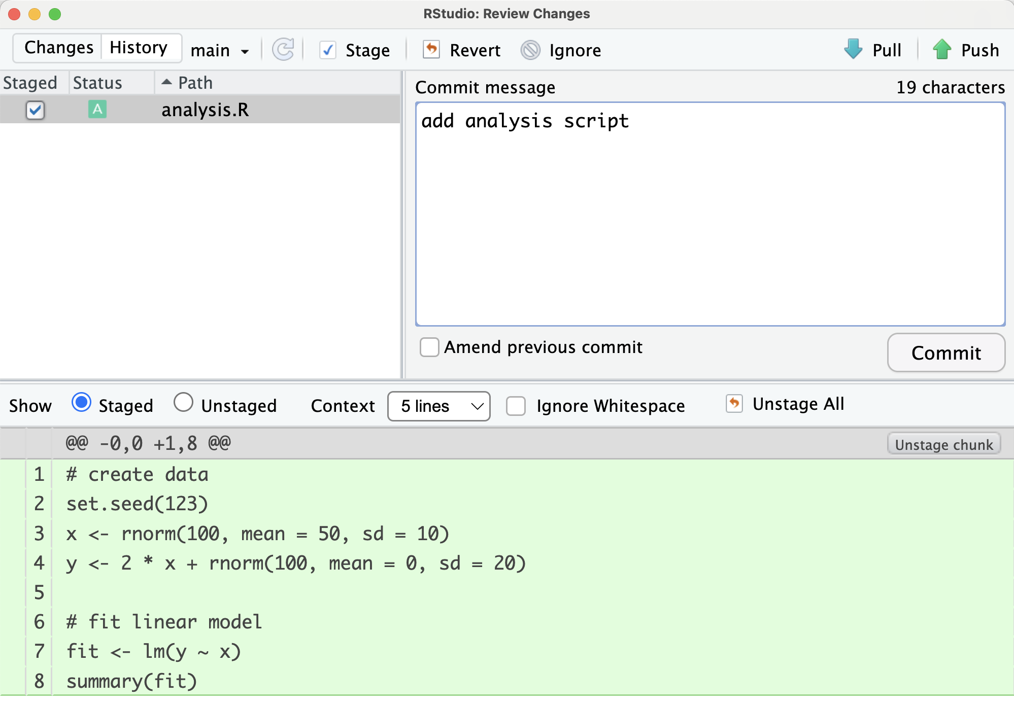
Add files to repository
Save, stage, commit, and push the files
Click on “Commit”, add a “Commit message”, then “Commit” again

Slide 37
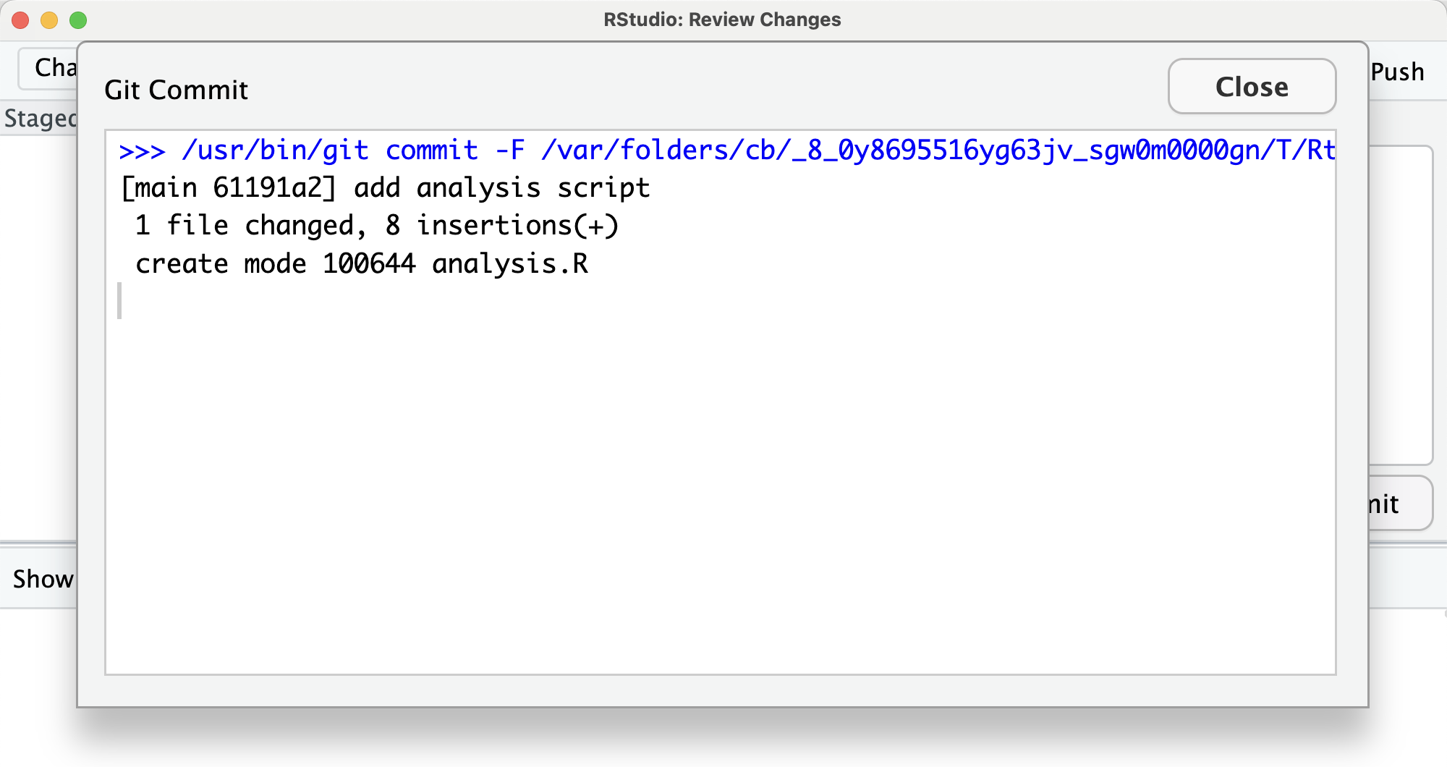
Add files to repository
Save, stage, commit, and push the files
Click on “Commit”, add a “Commit message”, then “Commit” again

Slide 38
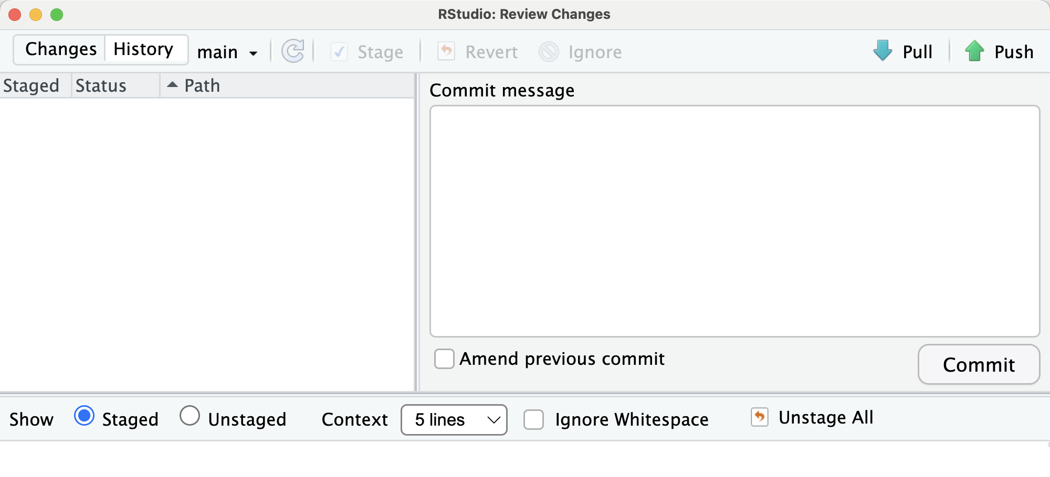
Add files to repository
Save, stage, commit, and push the files
Then click on “Push” (at the top-right)

Slide 39
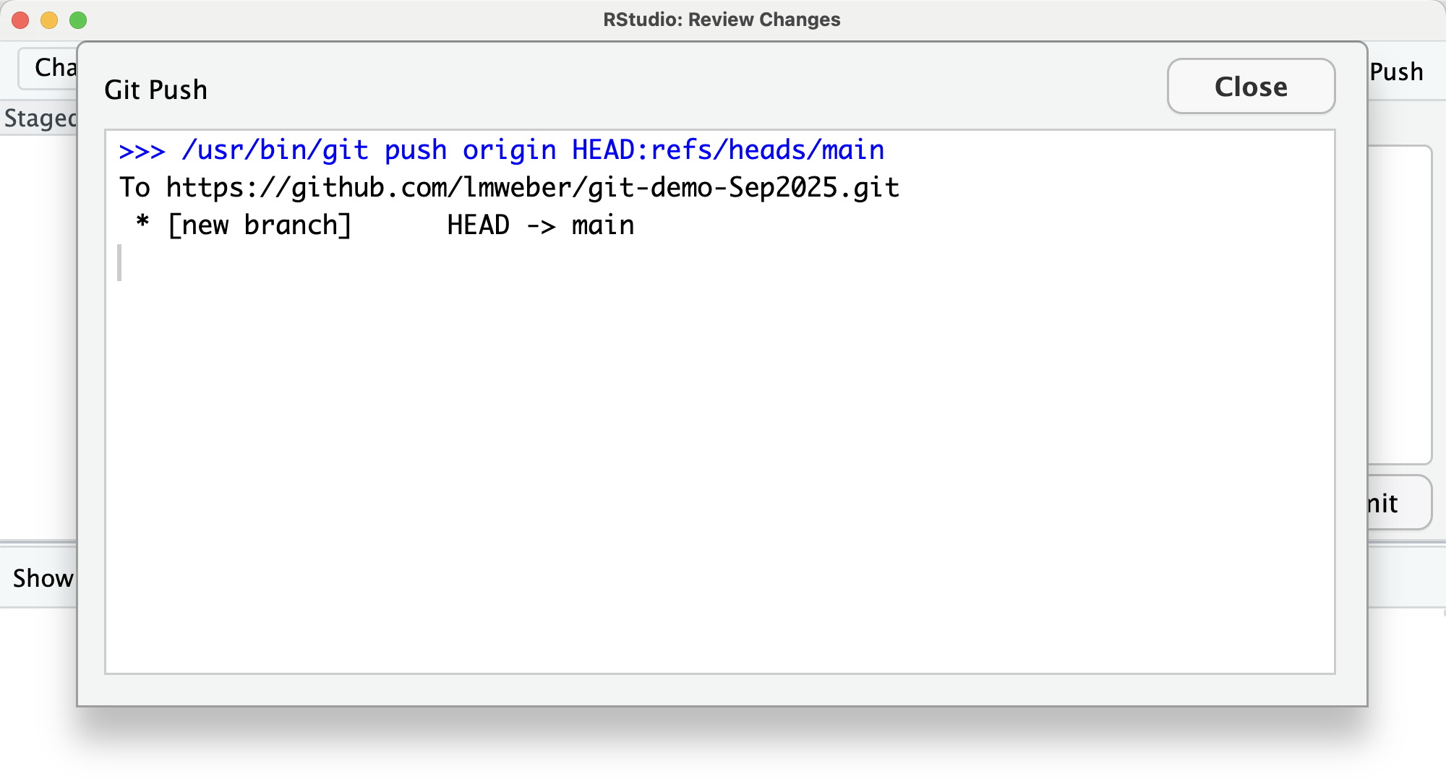
Add files to repository
Save, stage, commit, and push the files
Then click on “Push” (at the top-right)

Slide 40
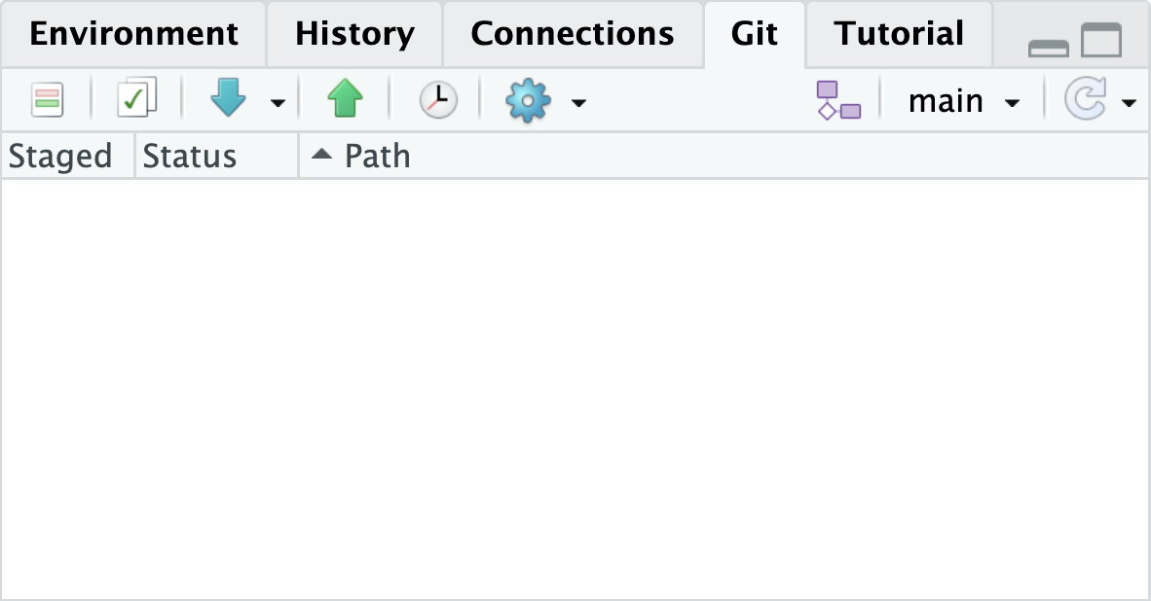
Add files to repository
Now the “Staged” area in the Git panel shows no further changes in the repository
Alternatively: type git status in RStudio Terminal

Slide 41
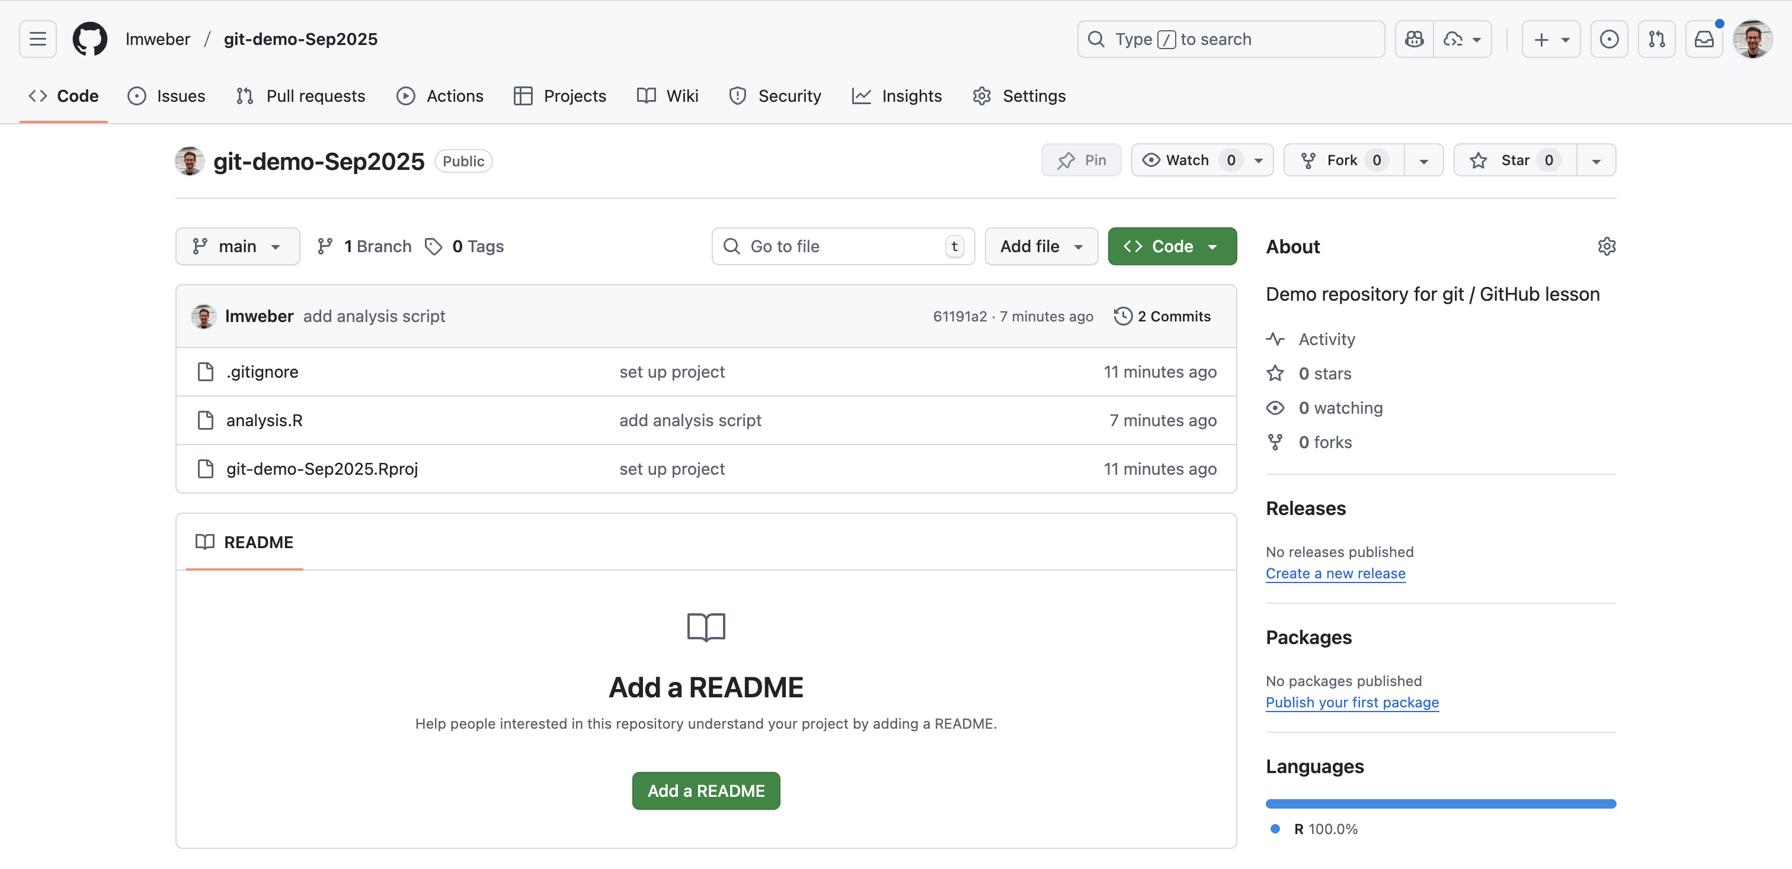
Add files to repository
Congratulations! You have pushed your first commits to GitHub
Check the updates on the GitHub repository page online

Slide 42
Add files to repository
Congratulations! You have pushed your first commits to GitHub
Check the updates on the GitHub repository page online
More details: Software Carpentry lesson: https://swcarpentry.github.io/git-novice/03-create.html

Slide 43
Additional topics
Pull changes from GitHub (e.g. changes added to repository by someone else)
“Pull requests”
“Branches”
Merging and “merge conflicts”
Commit history / git log
Commit hashes (unique ID for every commit)
Commit message style
Types of files to commit (mainly code and text, small files)
.gitignore file (e.g. exclude directories with large files: data/, plots/, etc)
Using Git from command line (alternative to RStudio interface)
See Software Carpentry lesson for details: https://swcarpentry.github.io/git-novice/03-create.html

Slide 44
Exercises
Add additional code to create a plot to the analysis script, and push the changes to GitHub. Check that you can see the updated code and the commit history on GitHub.
Add the person sitting next to you as a “Collaborator” to your GitHub repository (you can find this in “Settings” for the repository – note this is in the repository settings, not your GitHub profile settings). Ask your collaborator to push a new commit to the repository from their laptop. Then pull these changes to your local repository on your laptop and check if your files are now updated.
Set up a repository for one of your courses that involves R programming, or for a research project you are working on. Add a code script for a current assignment or your current research work. Then add new commits / updates to this repository over the course of the semester to keep a record of your work. (Note that you can choose whether the repository is public or private in settings.)

Slide 45
Thank you!

